Slide 1
A Policy Perspective
Fergal Costello
Government Accounting Unit
Department of Public Expenditure and Reform

Slide 2
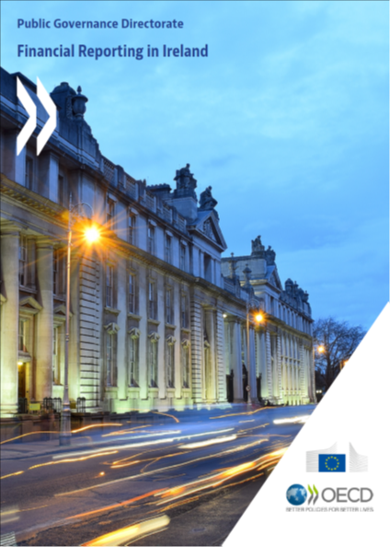
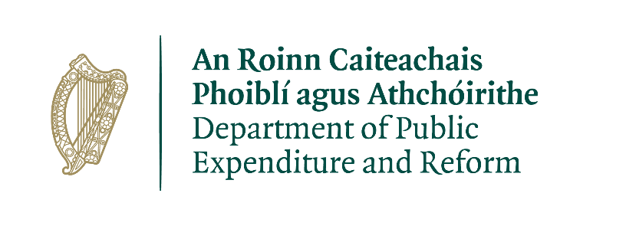
OECD Report Financial Reporting in Ireland
The OECD was commissioned to conduct the assessment of the accounting framework and produce a report recommending financial reporting reforms.
Report and recommendations for phased implementation of financial reporting reforms is available on http://www.oecd.org/gov/budgeting/Financial-reporting-in-Ireland-web.pdf
Ireland wishes to be in a position of preparedness for any changes at EU level concerning harmonised European Public Sector Accounting Standards (EPSAS).
Notes:
In 2018 we applied to the EU Structural Reform Support Programme for aid with reviewing, and ultimately implementing reforms to central government accounting framework. The OECD were tasked with this review, which built upon the IMF’s earlier work on Fiscal Transparency carried out in 2013.
In order to provide a more complete picture of Ireland’s fiscal position, the OECD have recommended a move from the current cash basis of accounting with some aspects of an accrual nature used at central government to a more complete accrual basis.
This will allow for greater coherence and comparability among accounts at central government and at an EU/international level. This along with our adoption of the International Public Sector Accounting Standards (IPSAS), will also allow for Ireland to be prepared for any developments with EPSAS when they occur.

Slide 3
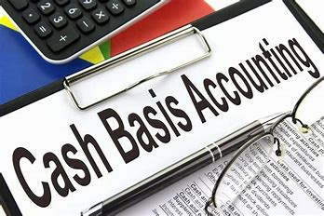
OECD Assessment
Cash accounting considered important basis for budgeting and reporting on budget execution, but current system
“Dated” financial reporting: framework not aligned with accounting practices in other OECD/EU countries;
Focus on short-term rather than long-term financial management: lack of information on assets and liabilities;
Perceived gaps in available information: stakeholders identify issues with completeness, clarity and timeliness of financial reporting;
Fragmented modernization effort: not grounded in strategic mandate.

Slide 4
Rationale for Moving to Standards based Accrual Accounting
Accrual Accounting creates the ability to recognise, value and manage public sector assets and liabilities.
Facilitating better financial management;
Improving understanding of program costs;
Expanding and improving information for resource allocation;
Improving financial reporting;
Facilitating improved asset and cash management.
Complementing performance management and measurement of performance.
Aligned with international standards

Slide 5
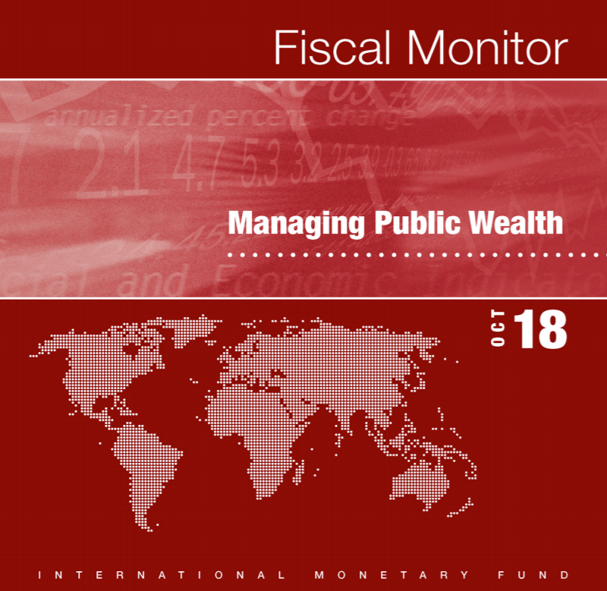
Expand the focus on public sector financial management
Ireland – huge focus on role of Budget – annual changes in allocations to Departments, and State Bodies.
Strong focus on volume of national debt and debt metrics
Lesser public focus on wider Government balance sheet
Long term liabilities – pensions, medical claims/liabilities
Assets – particularly property
IMF assessment – performance gains from better use of Government assets?
“overall revenue gain from improved management of nonfinancial public corporations and government financial assets of 3 percent of GDP”

Slide 6
OECD Recommendations
  Financial reporting reforms should be grounded in objectives of greater transparency and accountability with three core elements:
  Simplification: Appropriation Accounts redesigned into an integrated report showing budget execution (cash); assets and liabilities (accruals); and strategic objectives/achievements (performance);
  Timeliness: Reducing time frame for publishing Appropriation Accounts after year-end;
  Harmonization: Alignment of accounting practices across government and production of a consolidated Central Government Financial Statement.

Slide 7
Government Memo - Modernisation of Public Financial Reporting and Accounting
Government noted (15th October):
range of reforms to Ireland’s public financial reporting and accounting system, in line with international standards and best practices, recommended in the recent OECD report Financial Reporting in Ireland (2019) which builds upon earlier recommendations from the International Monetary Fund (2013 and 2017);

Slide 8
Road map for delivery
Structures/processes established
Engagement with Finance Officers, C&AG
Standing Advisory Group of external experts (academia and professional bodies)
Goals
Adopt IPSAS as basis for accounting
Review of IPSAS framework for application in Ireland
Consideration of conceptual framework and individual standards
Development of specific policies for the preparation of appropriation account

Slide 9
Road map for delivery
Assessment of capacity of Departments/Votes
Review of legislation
Communication of change, and value of change
Longer term goals
Wider harmonisation and consolidation of Government financial reporting
Whole of Government balance sheet

Slide 10
Contact Details
Fergal Costello, Government Accounting Unit – govacc@per.gov.ie
Website – govacc.per.gov.ie
Thank you

