Slide 1
Validating the Model
Paul McKeown
Enterprise Ireland CFO/Executive Director
Audit Insights - Financial Management Maturity Model
20th November 2020

Slide 2
Validating the Model
Enterprise Ireland – Overview
Approach to validating the Model
Report Findings
Observations & Reflections

Slide 3
Enterprise Ireland - Overview
Works with 5,000 Irish-owned businesses across all sectors of manufacturing and internationally-traded services
Offers leadership, competitiveness, innovation, networking and financial supports made to match ambition at every stage
Mandate to drive collaboration and commercialisation of state-funded research
40 international offices; 10 regional offices in Ireland
Key focus is the development and growth of Irish companies in global markets
Enterprise Ireland is the state agency responsible for the development and growth of Irish-owned companies in global markets.
We work with early-stage entrepreneurs, established businesses and Irish multinationals to help them start, grow, innovate and win export sales.

Slide 4
Enterprise Ireland – Overview (continued)
Gross Expenditure of c.€410m (FY 19)
  Split across:
    Direct Client Expenditure
    Third Parties Funded (LEOs, DCCI & BICs)
    OPEX
Significant income generation (FY19: €108m)
    Driven predominately by investment activities
    Substantial direct equity and seed & venture capital portfolios

Slide 5
Approach to validating the Model
Self Assessment
Engagement with Mazars

Slide 6
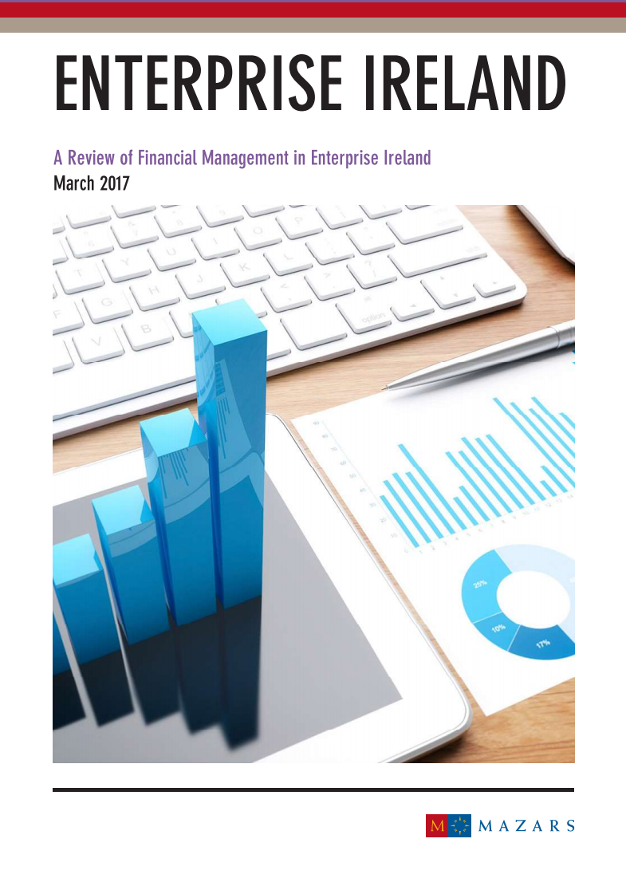
Report Findings
Report addresses the Model’s 15 questions across the 5 themes:
  Financial governance and leadership
  Financial Planning
  Financial information for decision making
  Financial monitoring and forecasting
  Financial and performance reporting
Over 50 examples of good practice outlined
4 areas for potential improvement identified

Slide 7
Observations & Reflections
Very useful tool to systematically review our financial management
  Absence of the model would have made this significantly harder
Straightforward and intuitive
  Key advantage for wider engagement outside of Finance
Practical approach underpinned by robust structure & theory
  Identified tangible ways we could further enhance our approach
Scalable in terms of:
  Size of organisation; and
  Scope of review

Slide 8
Observations & Reflections (continued)
Strong time/benefit return
  Particularly given scalability of model – adapt to particular needs
Key role of people & culture in strong financial management
  Supports questioning and continuous improvement mindsets
  Identification/confirmation of good practice allows for team acknowledgement & recognition…
  …while providing clarity and a roadmap as to how to be even better in the future

Slide 9
Thank You

